Slide 1
SENIOR MEETING
Class of 2018

Slide 2
Important Dates:
Thursday, May 24, 2018 Last day of instruction for Seniors and Senior Final Exams​
Tuesday, May 29, 2018 Day 1 Graduation Practice in the OHS gymnasium.
8:00 am – 11:30 am Caps and gowns will be distributed during practice.
Wednesday, May 30, 2018 Day 2 Graduation Practice in the OHS gymnasium.
8:00 am – 10:00 am Graduation gown required for panoramic photo taken during practice.
*10:00 am – 12:00 pm Salute to Seniors Awards Program (two tickets) in the OHS
auditorium.
Thursday, May 31, 2018 Day 3 Graduation Practice in the OHS gymnasium.
8:00 am – 11:00 am Graduation tickets (eight tickets) will be distributed during practice.
All financial obligations must be paid in full by 12:00 noon.
Friday, June 1 OHS Graduation in Knott Arena at PNC Sports Complex
*seniors report by 9:00 am Mount Saint Mary’s University, Emmitsburg, Maryland
Ceremony at 10:00 am
Friday, June 1 OHS Safe and Sane Party
9:00 pm – 5: 00 am Knott Arena at PNC Sports Complex
Mount Saint Mary’s University, Emmitsburg, Maryland

Slide 3
Graduation National Anthem information
National Anthem Auditions: those interested in singing the national anthem prior to the graduation ceremony need to sign up. There will be a sign up sheet on the band room door. Deadline to sign up is Friday, April 6th.
Graduation-themed musical selection Audition: those interested in performing need to sign up on the sheet on the band room door. Deadline is also Friday, April 6th.
Auditions for both will be in the band room after school on May 1st.
It can be in the key of your choice and will be a cappella for auditions with a starting pitch on the piano if you need it. Solos and ensembles are welcome to audition.

Slide 4
Graduation Speech information
1. Graduation Speech Auditions: those interested in speaking at graduation must turn in their speech to Ms. Ketteringham by Thursday, April 6th . NO EXCEPTIONS! 2 minutes in length.
2. Auditions will be held after school Wednesday, April 18th.

Slide 5
Marching Partner Form
Friday, March 23rd deadline.
Choose your marching partner carefully, no changes will be made once the form is turned in.

Slide 6
Balfour/Cap and Gown and announcement information
Balfour updates – Cap and Gown ordering/deadline (April 30th); may order online
List of those who have not ordered. If you are not sure see Mrs. Polce.
Caps and gowns will be distributed on the 1st day of practice Tuesday, May 29th.
Balfour orders of any other items (announcements) will be mailed home.

Slide 8
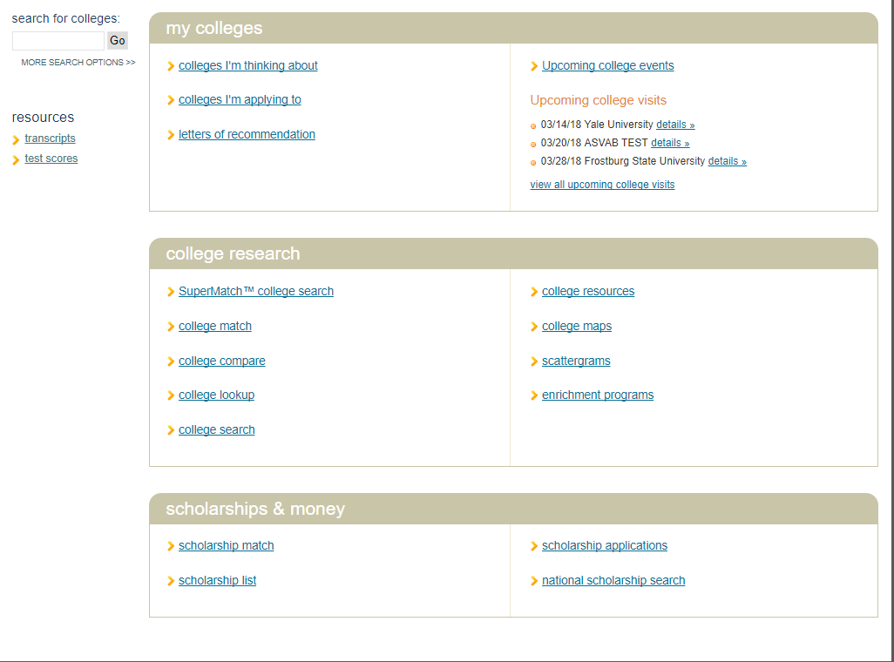
Scholarships - Naviance

Slide 9
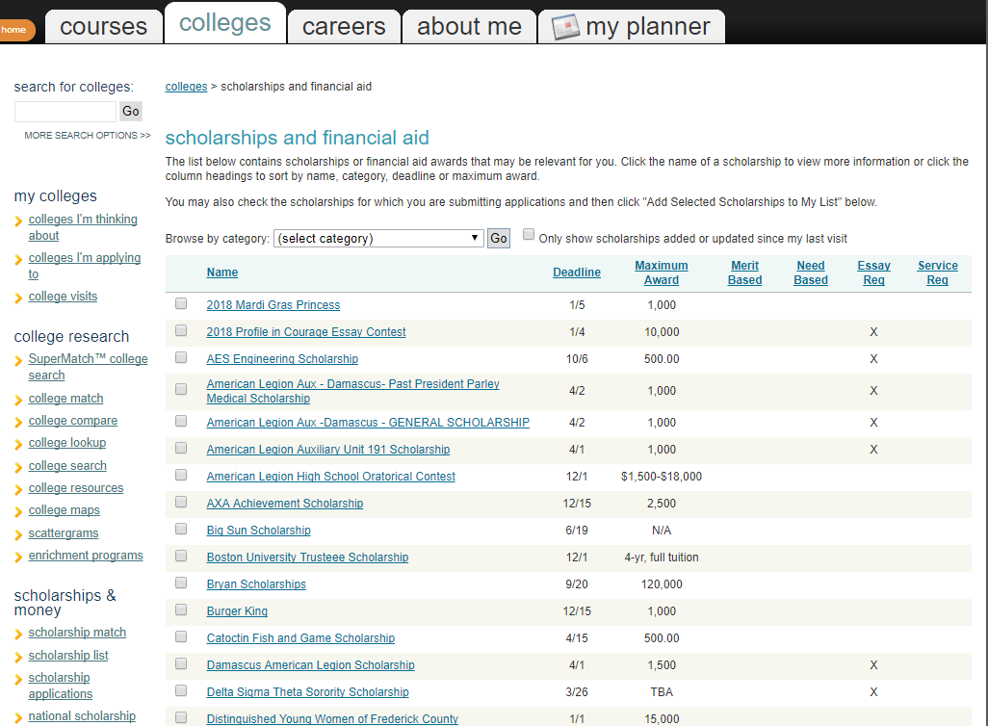

Slide 10
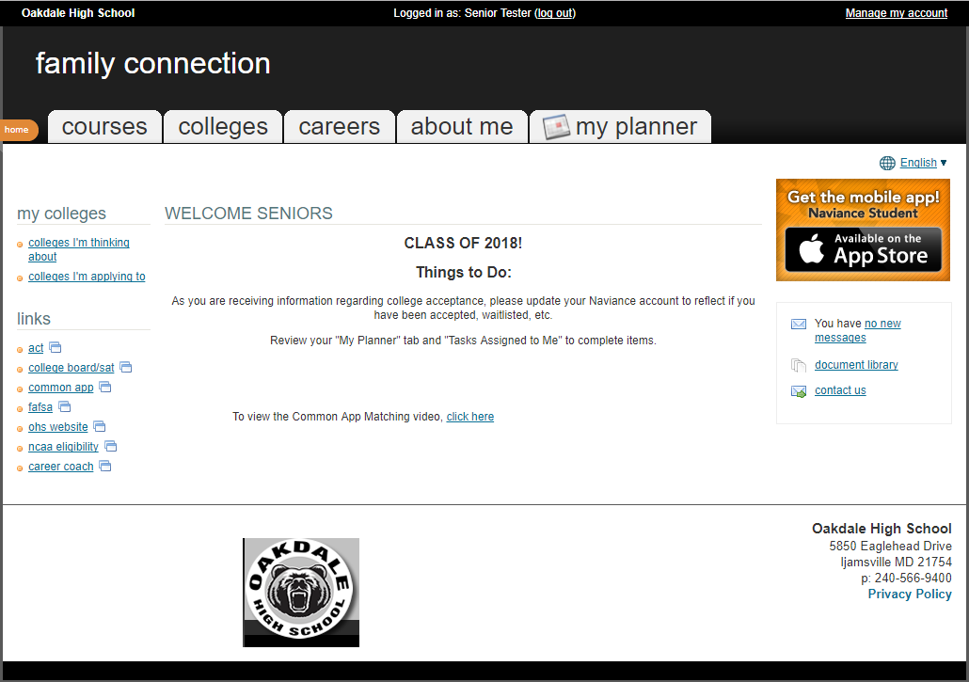
Naviance Updates

Slide 11
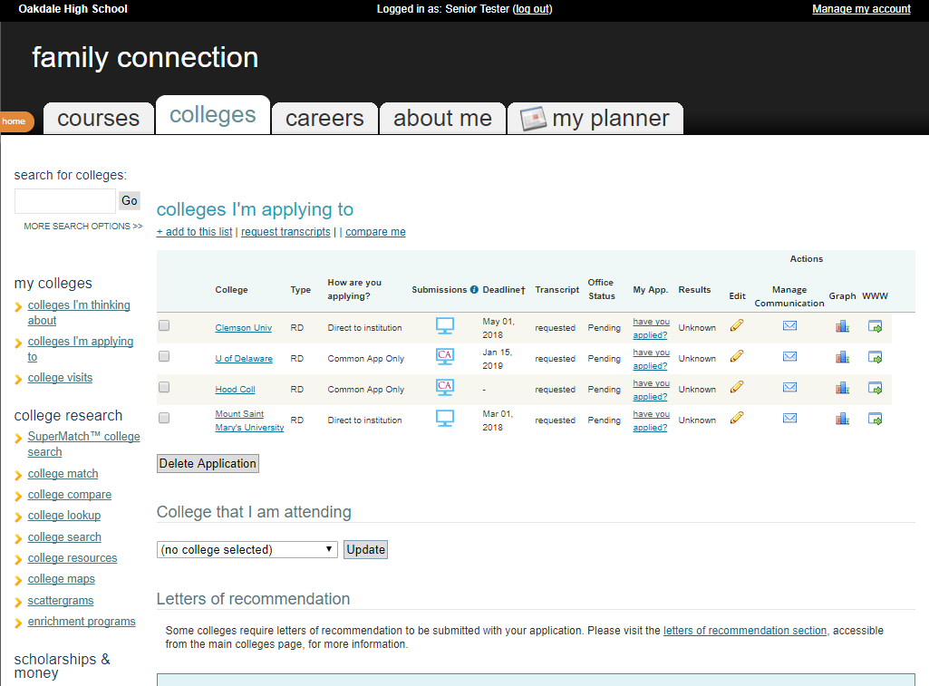

Slide 12
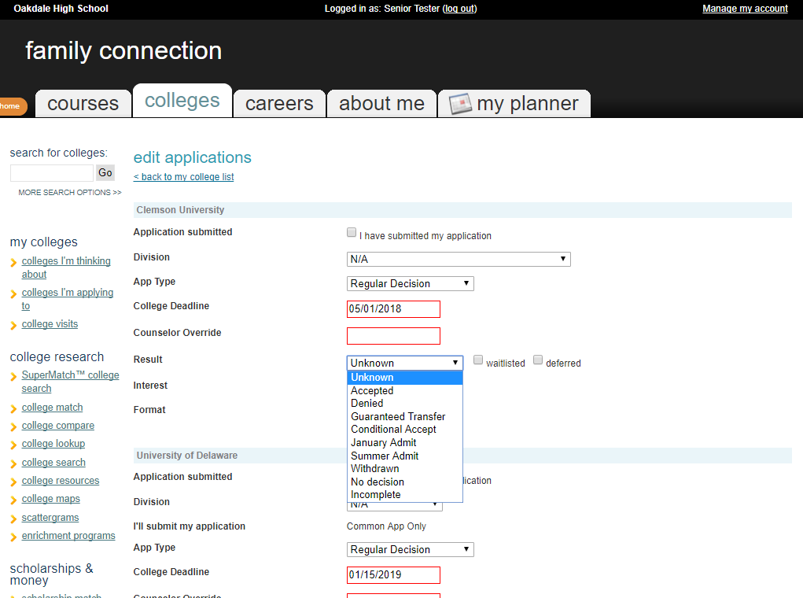

Slide 13
Safe and Sane Information

